Slide 1


Home Credit – Credit Scoring
Predicting whether a loan will be repaid with or without difficulty
Ivan Hartana
https://github.com/ivanhrtn/Data-Scientist-Virtual-Internship-Experience

Slide 2
Approaches
Uses Supervised Machine Learning to identify loan that repaid with or without difficulty
Data cleansing using several methods (since ML model cannot inherently deal with text) based on choices and assumptions
Exploratory data analysis
Feature Engineering – split training and testing sets with 66.66 : 33.33 ratio
Predictive Modeling:
Expected Target Outcome: 0 or 1, 0 – without difficulty, 1 – with difficulty.
Performance Metrics used : Accuracy.
Models currently used : Logistic regression, Random forest, XGBoost, LightGBM, Naïve bayes, Model ensemble.
01

Slide 3
Datasets
application_train.csv
307511 Records, 122 Columns
Imbalanced Target Labels.
Source for training machine Learning models.
Target Labels :
0’s – 282686, 1’s - 24825
application_test.csv
48744 Records, 121 Columns
No Target Labels.
Source for testing the performance of machine Learning models.
Target Labels :
None – need to predict.
02

Slide 4
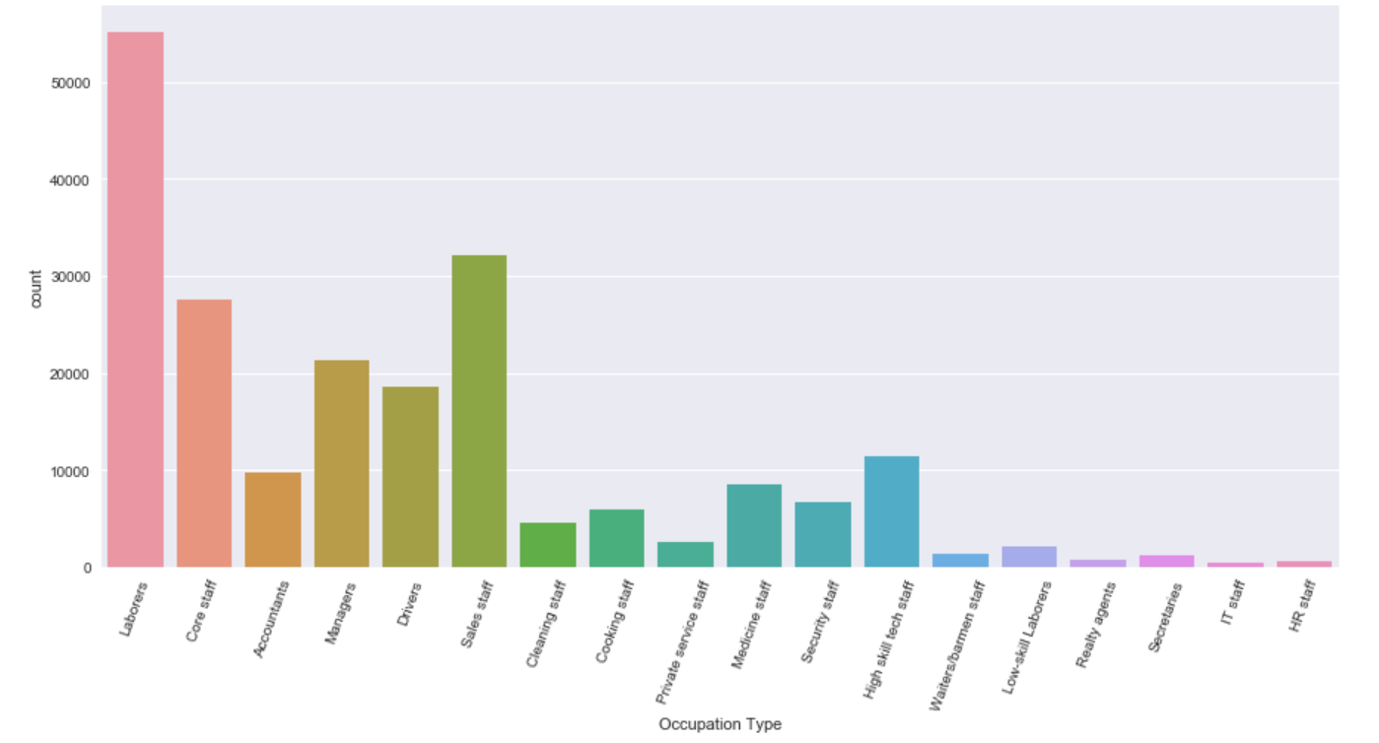
EDA and Visualization 1 – Occupation vs. Amounts of Loan
10

Slide 5
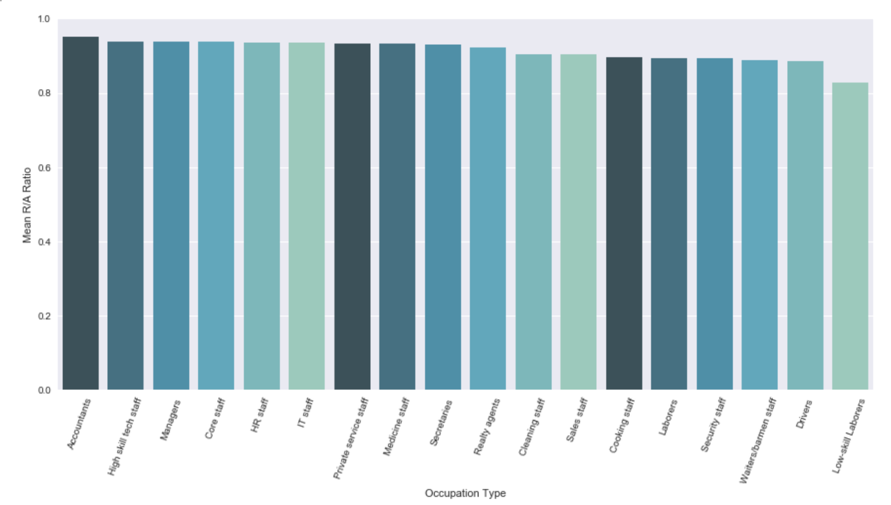
Visualization 2 – Occupation vs. Capability to Repay a Loan
10

Slide 6
From previous visualizations, we could gain valuable
business insights:
Managers and core staffs – top 5 amounts of loan applied, and top 5 in terms of capability to repay the loans, do not let them go away!!
Accountants are our most capable applicants, BUT they are not even our top 5 applicants based on the amounts of loan applied. So, we should direct and strategize our campaign to accommodate more accountant to apply more loans to us
HR staffs and IT staffs – our 2 least amounts of loan applied, even though they are highly capable to repay the loan, so we could target them also for our next campaign
Laborers are by far our most amounts of loan applied, BUT they seem to have more difficulties to repay the loan. In order to retain them, we could design our products of loan more friendly for them, by, for example, decreasing the rate of interest, increasing the repayment periods, and putting more emphasize to their annual income before approving the applied loans
05

Slide 7
Currently there are 6 models used.
Model Name | Hyperparameters | Accuracy
LogisticRegression | (C=2, class_weight=None, dual=False, fit_intercept=True, intercept_scaling=1, max_iter=100, multi_class='ovr', n_jobs=1, penalty='l2', random_state=None, solver='liblinear', tol=0.0001, verbose=0, warm_start=False) | 92.01%
RandomForestClassifier | (bootstrap=True, class_weight=None, criterion='gini', max_depth=None, max_features='auto', max_leaf_nodes=None, min_impurity_decrease=0.0, min_impurity_split=None, min_samples_leaf=1, min_samples_split=2, min_weight_fraction_leaf=0.0, n_estimators=500, n_jobs=-1, oob_score=False, random_state=50, verbose=1, warm_start=False) | 91.98%
XGBClassifier | (base_score=0.5, colsample_bylevel=1, colsample_bytree=1, gamma=0, learning_rate=0.1, max_delta_step=0, max_depth=5, min_child_weight=1, missing=None, n_estimators=250, nthread=-1, objective='binary:logistic', reg_alpha=0, reg_lambda=1, scale_pos_weight=1, seed=0, silent=True, subsample=1) | 92.06%
LightGBM | (boosting_type='gbdt', class_weight=None, colsample_bytree=1.0, learning_rate=0.1, max_depth=-1, min_child_samples=20, min_child_weight=0.001, min_split_gain=0.0, n_estimators=100, n_jobs=-1, num_leaves=31, objective=None, random_state=None, reg_alpha=0.0, reg_lambda=0.0, silent=True, subsample=1.0, subsample_for_bin=200000, subsample_freq=0) | 92.04%
NaïveBayesClassifier | (priors=None) | 32.63%
All Stacked | Same as above, but voted. | 92.04%
06
More Explanation in Notebook.

Slide 8
XGBoost is currently the best chosen model, Until further work.
More feature engineering could be done, such as mathematical transformation, possibly: certain columns to log and such.
Advanced techniques like SMOTE could be deployed to handle the class imbalance problems.
DNN’s can be used.
Long short term memory networks could be used to incorporate time series data.
Advanced forms of stacking can be used apart from voting.
Recursive feature selection can be used to reduce the features.
07

Slide 9
Value add to this project.
Performed data wrangling / cleaning, setting up the data for analysis and model building.
Dealt with data having anomalies.
Added Interaction variables.
Performed hyperparameters optimization.
Incorporated Domain Feature engineering.
Performed Exploratory Data Analysis.
Discovered patterns in data.
Built bagging based ensemble model.
08

